Slide 1
Predictive Modeling for Technical Price Estimation
Group 10
Exploring Insurance Claims Data with Machine Learning in R
Group members:
SMAILA AMOANU
Derrick Chilenga
FELIX JAMES
Callixte NDIZIHIWE
8th March, 2024

Slide 2
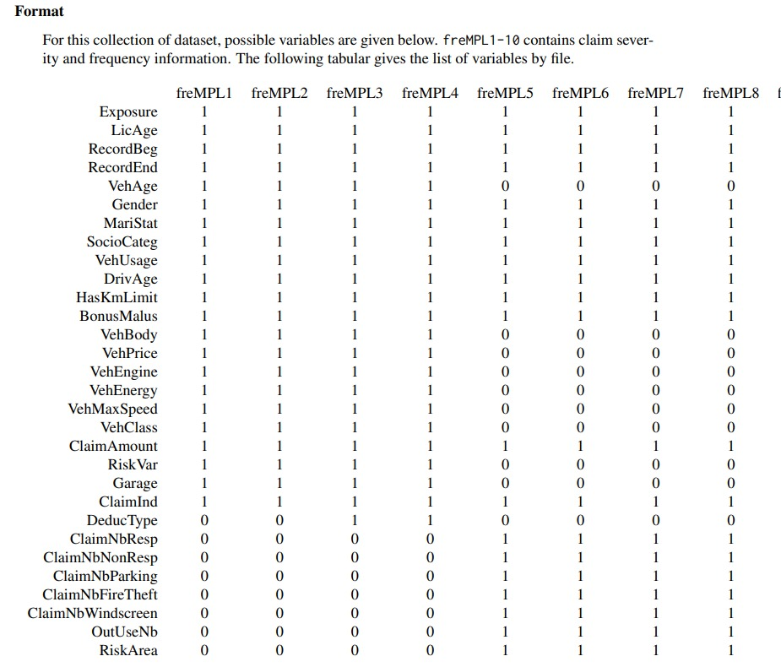
Introduction
About the data
French Motor Personal Line datasets: data(freMPL3)
freMPL is collection of ten datasets comes from a private motor French insurer. Each dataset includes risk features, claim amount and claim history of around 30,000 policies for year 2004.
Data source
CASdatasets

Slide 3
Objectives
Training a predictive model to estimate the technical price, which represents the conditional expectation of claimAmount given Exposure=1.
Globally interpret the model, and locally interpret estimates of examples in the data.
Ascertaining predictive accuracy with the use of appropriate regression metrics such as the R-squared, and RMSE.
Estimating some rows of the test data.

Slide 4
Methods (procedures)
Algorithm or models: KNN, Random forest, XG Boost (Regression based)
Loss function: Squared error loss (quadratic loss)
Performance evaluation metrics: Root Mean Square Error (RMSE), R-square
Splitting: 80% train, 20% test
Preprocessing techniques: Scaling, target encoding.
Model or estimates explanation: Partial Dependence Plot (PDP), shapley values, SHapley Additive exPlanations (SHAP).

Slide 5

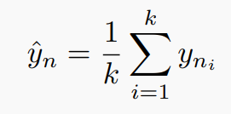




Theoretical background
Random forest
Assemblage of regression trees to make predictions for new observations.
K-Nearest Neighbour
Averaging outcomes in a neighbour to predict new observation.
XG Boost
Prediction is obtained by summing up the predictions of all trees (weak learners)
Shapley value
Partial Dependence Plot

Slide 6
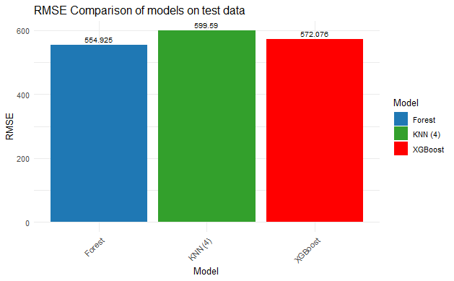
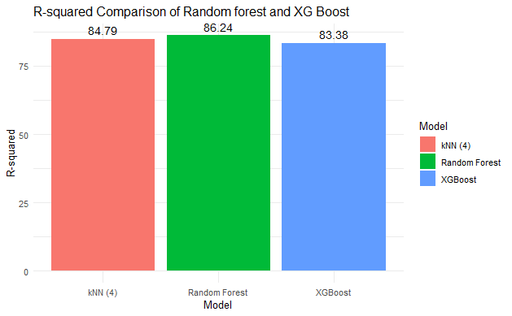
Model explanation
Goodness of fit
Random forest has the least RMSE followed by XG Boost,
on the test set.
KNN has the greatest RMSE on the test set.
Most errors are explained in the Random forest comparatively to KNN and XG Boost.
XG Boost has the least error explanatory ability
Good R-squared is a necessary but not a sufficient condition to ascertain good machine or model.

Slide 7
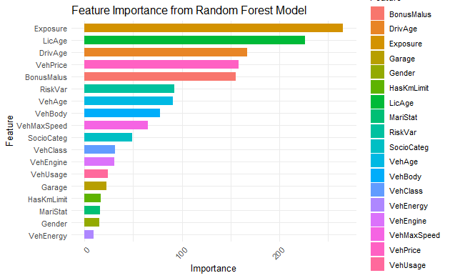
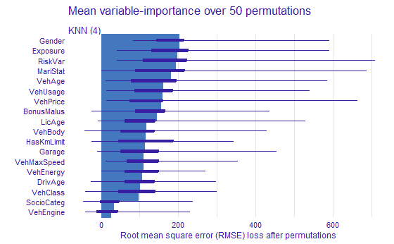
Feature importance and contributions
Global Explanation
SHAP
All features are important in the predictions.
Most numerical features contribute greatly to predictions of Technical price compared to categorical features.
Gender contributes greatly compared to the rest of the features in KNN.
VehEnergy has the least contribution in all the models.

Slide 8
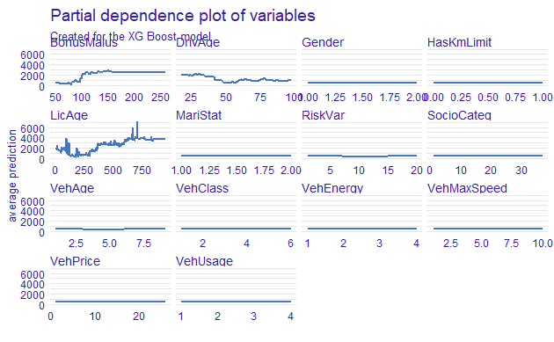
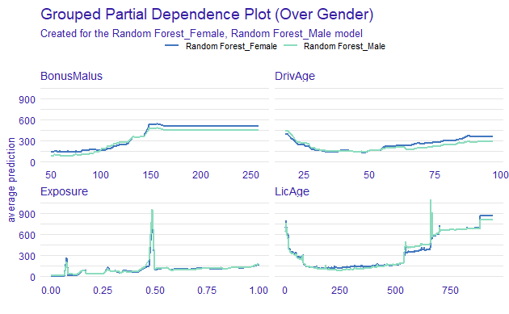
Partial Dependence Plot
Global Explanation
Relationship between VehAge and ClaimAmount is complex. However, policy holders with old vehicles have high claim amounts compared to recent vehicles.
Experienced drivers have least claim amounts compared to new drivers.
Variables contributions or relationships to technical price differ between males and females.

Slide 9
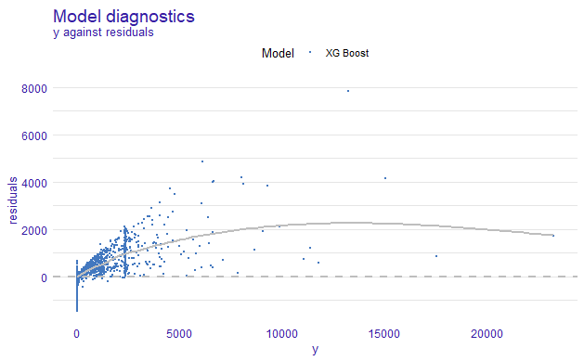
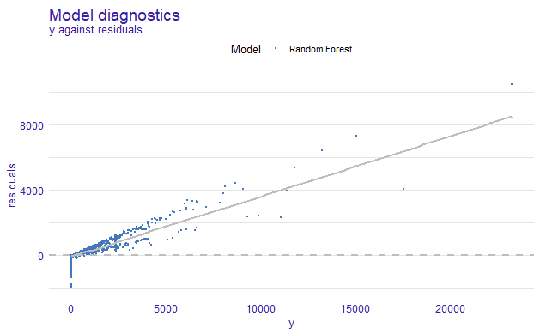
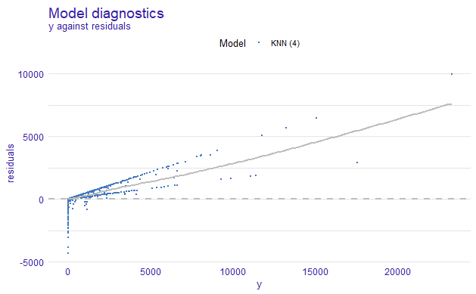
Residual diagnostics
Goodness of fit
Residuals are more random in the XG Boost compared to KNN and Random Forest.
Residuals of Random forest and KNN tends to have a definite pattern, thus not completely random.

Slide 10
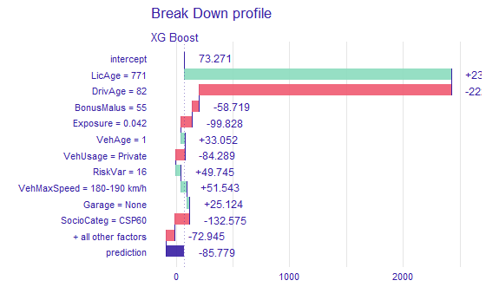
Predictions of examples in the test set
Row | Actual | Estimate
1386 | 0 | 643.3573
2119 | 0 | 0
2238 | 0 | 0
Row | Actual | Estimate
1386 | 0 | 21.829664
2119 | 0 | 56.386524
2238 | 0 | 2.527776
Row | Actual | Estimate
1386 | 0 | -19.37053
2119 | 0 | -85.77905
2238 | 0 | -149.69469
KNN
Random forest
XG Boost
Local explanation
Explaining the prediction for an example.
Random forest predictions are too far from the truth
KNN and XG Boost produced better estimates.

Slide 11
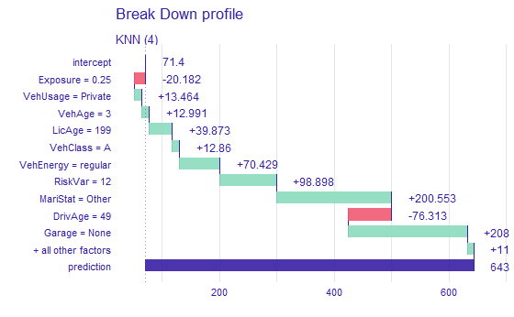
Predicting examples in the test set
KNN
Row | Actual | Estimate
1386 | 0 | 643.3573
2119 | 0 | 0
2238 | 0 | 0
MariStat contributed greatly to this prediction, followed by Garage.
Exposure, and DrivAge have negative effects in the predictions.

Slide 12
Conclusion
Random forest and KNN are able to explain great amount of the variabilities in technical price compared to XG Boost.
All features are important in predicting the technical price in the dataset.
Contributions of most features vary between males and females.
KNN (4) and XG Boost are able to predict the technical price better than the Random Forest.

Slide 13
References
Y. Freund, and R. Schapire, “A Decision-Theoretic Generalization of On-Line Learning and an Application to Boosting”, 1997.
Dataset used in Frees, Carriere and Valdez (1995), Annuity valuation with dependent mortality,Actuarial Research Clearing House 1995, Vol. 2.
Friedman, Jerome H. “Greedy function approximation: A gradient boosting machine.” Annals of statistics (2001): 1189-1232.

Slide 14

Thank you!
Ask Questions.

